Slide 1
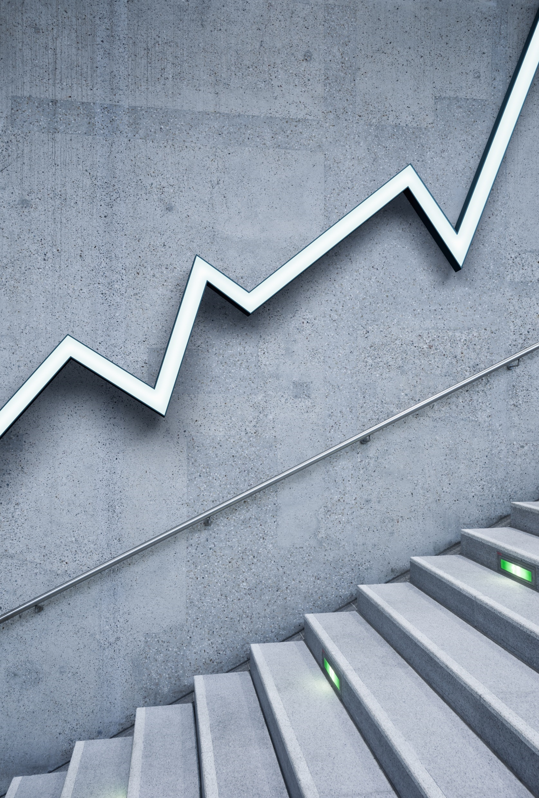
APP Trader: an analysis of apple & play store app
by Team dr pepper

Slide 2
Criteria to inform Top 10 apps
Apps common to both apple and play
Rating > 4.0
Review count > 100000 across both app stores and cross referenced this where play store install counts > 100M; install data was not available in the apple store table
Cost free
Games

Slide 4
Top 10 apps ROI
Year 1
Revenue | $ 300,000.00
Expenses | $ (112,000.00)
Profit | $ 188,000.00
Years 2-10 (108 mo)
Revenue | $ 3,240,000.00
Expenses | $ (108,000.00)
Profit | $ 3,132,000.00
Total Profit | $ 3,320,000.00
Investment Gain | $3,100,00.00
ROI | 1409.09%
Annualized ROI | 31.08%
Investment Length | 10 Years
Angry Birds
Candy Crush Saga
Clash Royale
Geometry Dash Lite
Hill Climb Racing
Jetpack Joyride
My Talking Tom
Subway Surfers
Temple Run 2
Trivia Crack

Slide 5


Slide 6
Backup
name | app_review_count | avg_app_rating | avg_app_life | play_genre | install_count | cost
Angry Birds Rio | 170843 | 4.6 | 10 | Simulation | 100,000,000 | $ 10,000.00
Candy Crush Saga | 961794 | 4.45 | 10 | Casual | 500,000,000 | $ 10,000.00
Clash Royale | 266921 | 4.55 | 10 | Strategy | 100,000,000 | $ 10,000.00
Geometry Dash Lite | 370370 | 4.75 | 11 | Arcade | 100,000,000 | $ 10,000.00
Hill Climb Racing | 108183 | 4.4 | 10 | Casual | 100,000,000 | $ 10,000.00
Jetpack Joyride | 405647 | 4.45 | 10 | Simulation | 100,000,000 | $ 10,000.00
My Talking Tom | 123859 | 4.5 | 10 | Casual | 500,000,000 | $ 10,000.00
Subway Surfers | 706110 | 4.65 | 10 | Casual | 1,000,000,000 | $ 10,000.00
Temple Run 2 | 295211 | 4.4 | 10 | Action | 500,000,000 | $ 10,000.00
Trivia Crack | 393469 | 4.5 | 10 | Trivia | 100,000,000 | $ 10,000.00
 |  | 4.525 | 10.1

